Slide 1

CAPSTONE PROJECT
SEPSIS PREDICTION
Chun Shan

Slide 2
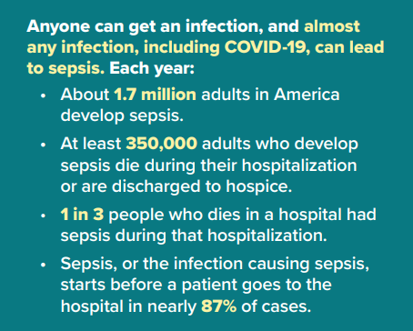
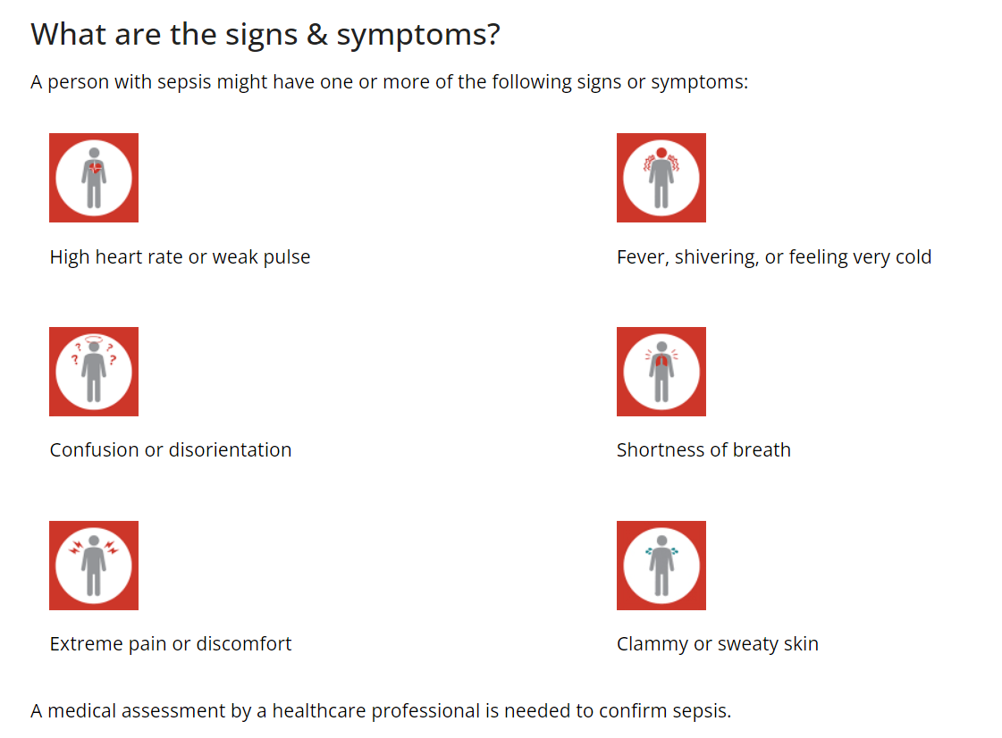
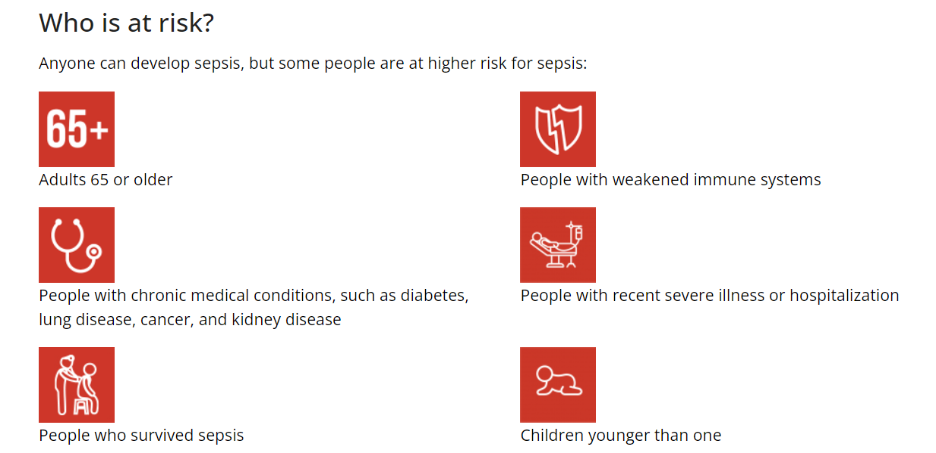
WHAT IS SEPSIS
WHAT IS SEPSIS
Infections can put you or your loved one at risk for sepsis. When germs get into a person’s body, they can cause an infection. If you don’t stop that infection, it can cause sepsis. Bacterial infections cause most cases of sepsis. Sepsis can also be a result of other infections, including viral infections, such as COVID-19 or influenza, or fungal infections.
From: https://www.cdc.gov/

Slide 3
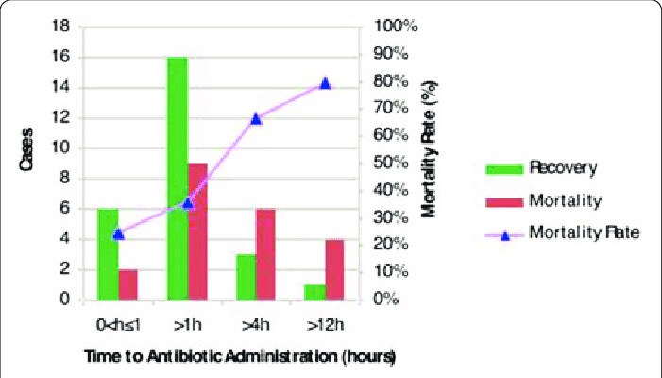
PROBLEM STATEMENT
Motivation for predicting sepsis
Sepsis definition:
Sepsis is a life-threatening organ dysfunction, caused by a dysregulated host response to infection.
Relevance of early recognition:
Bacterial species identification in blood still takes 24 – 48 hours
Each hour of delayed effective antibiotic treatment increases mortality
Detecting and treating sepsis earlier is of highest clinical interest
Proritise Recall: To minimize missed positive predictions which may lead to loss of lives
Image adapted from (abstract P20).
Time from diagnosis of severe sepsis to antibiotics.... | Download Scientific Diagram (researchgate.net)

Slide 4
GOALS
Tool to aid medical practitioners to make early informed decisions
Important Features
Build a Classification Prediction Model
Understand the important features in clinical diagnosis of sepsis in the ICU patients
Build a machine learning model to predict sepsis onset one hour before onset for all ICU patients
Simple deployment tool to recommend whether patient might turn septic as a decision support for medical practitioners

Slide 5
UNDERSTANDING THE DATA
Basic Demographics
Age, Gender, Hospitalisation Time, ICULOS (ICU Length of Stay)
01
Vital Signs
HR, O2Sat, MAP, SBP, DBP, Resp, EtCO2 etc.
02
Laboratory Values
BaseExcess, HCO3, FiO2, PaCO2, AST, BUN, AlkalinePhos, Calcium, Chloride, Creatinine, Bilirubin_direct, Serum Glucose, Magnesium, WBC, Platelets, Fibrinogen etc.
03

Slide 6
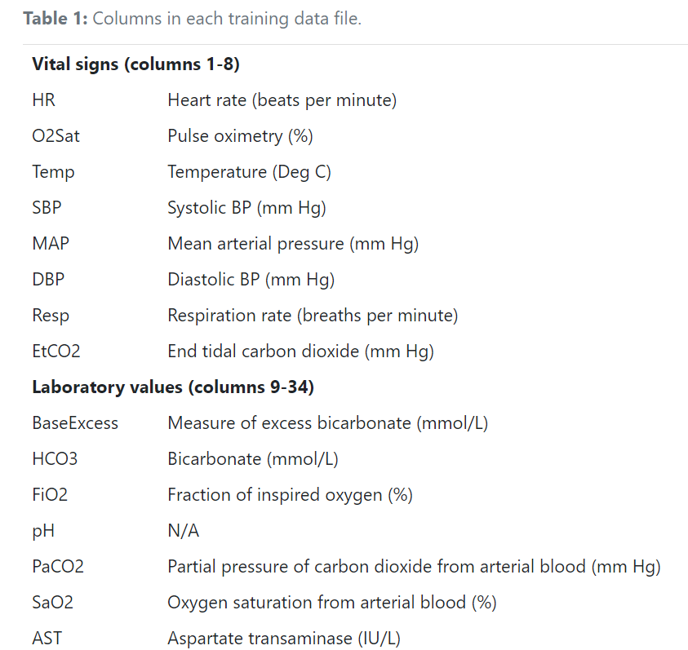
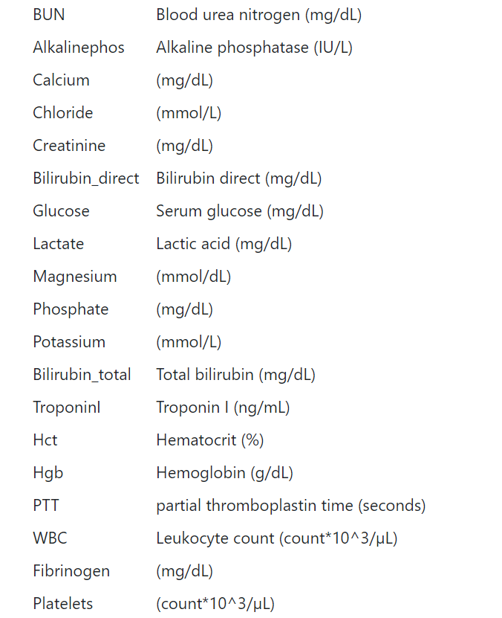
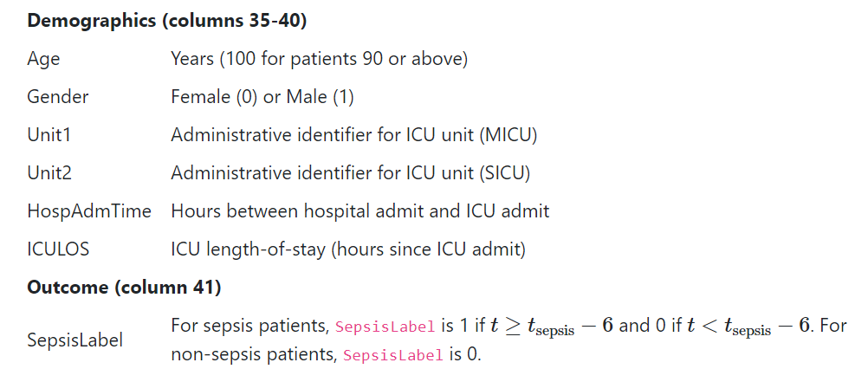
UNDERSTANDING THE DATA
Notes:
Each training data file provides a table with measurements over time. Each column of the table provides a sequence of measurements over time (e.g., heart rate over several hours), where the header of the column describes the measurement. Each row of the table provides a collection of measurements at the same time (e.g., heart rate and oxygen level at the same time). The table is formatted in the following way:
There are 40 time-dependent variables HR, O2Sat, Temp ..., HospAdmTime, which are described here. The final column, SepsisLabel, indicates the onset of sepsis according to the Sepsis-3 definition, where 1 indicates sepsis and 0 indicates no sepsis. Entries of NaN (not a number) indicate that there was no recorded measurement of a variable at the time interval.

Slide 7
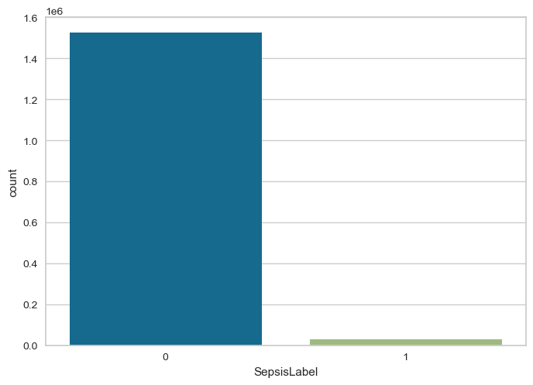
EXPLORATORY DATA ANALYSIS - OVERVIEW
Only about 1.8% of raw records indicate sepsis [27,916 / 1,524,294]
Out of 40,336 unique patients, only about 7.3% patients have onset of sepsis [2,932 / 40,336]

Slide 8
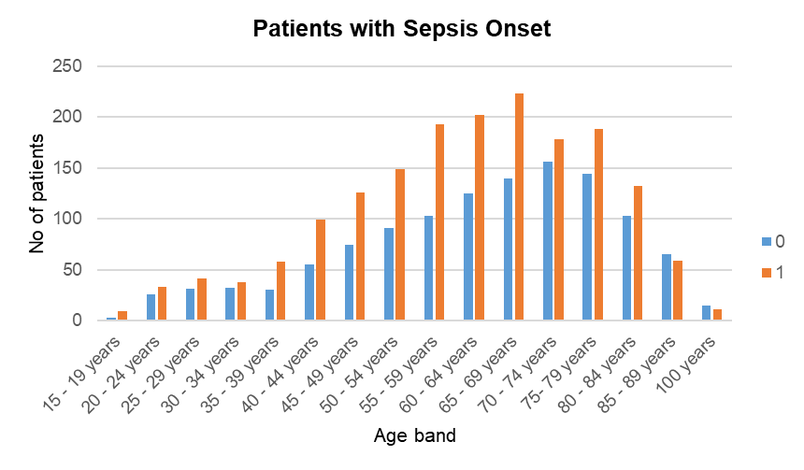
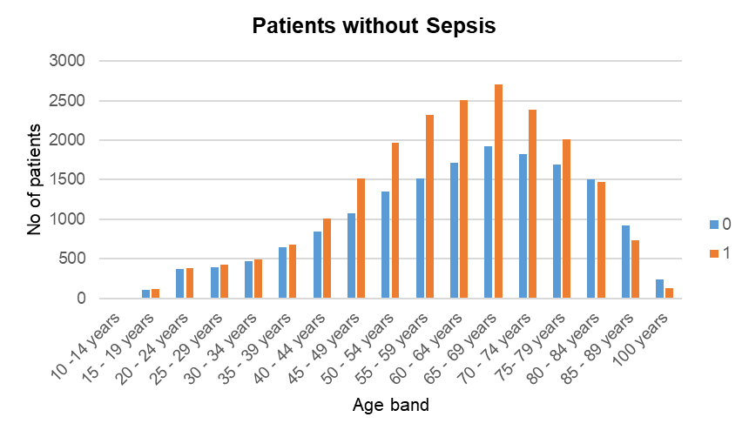
EXPLORATORY DATA ANALYSIS - Demographics
Distribution of Gender and Age groups do not show any particular subgroup of patients being especially prone to sepsis.

Slide 9
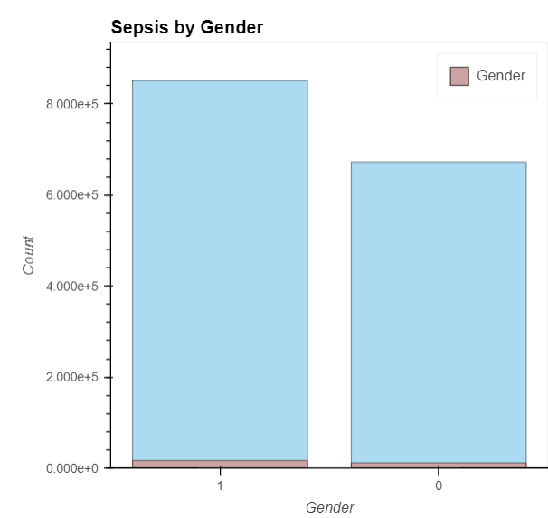
EXPLORATORY DATA ANALYSIS - Demographics
More patient data was collected for Gender 1 than Gender 0 in the entire dataset.
Higher proportion of Gender 1 turned septic (7.7%) compared to Gender 0 (6.7%)

Slide 10
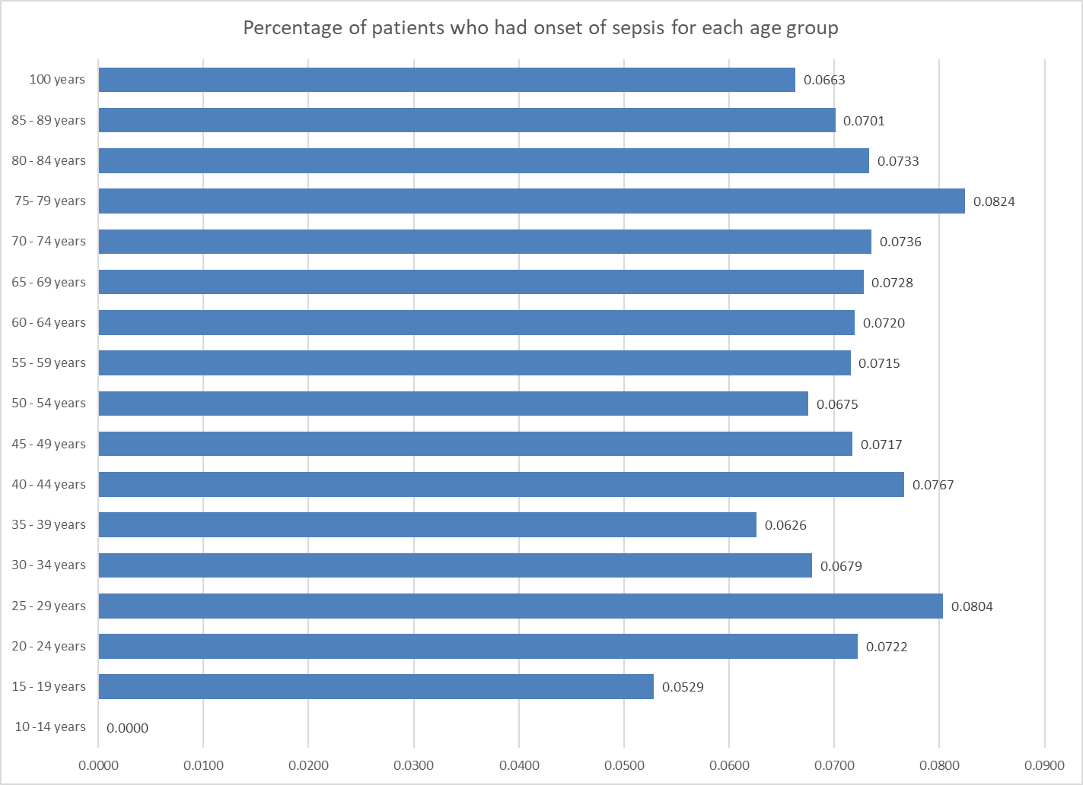
EXPLORATORY DATA ANALYSIS - Demographics
The percentage of patients in each age group who had onset of sepsis was highest for 20 - 24 years; 75 - 79 years
Data shows no particular trend that age group by itself relates to incidence rate of sepsis

Slide 11
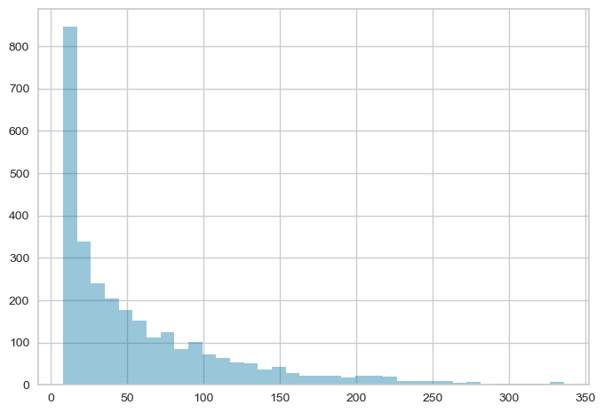
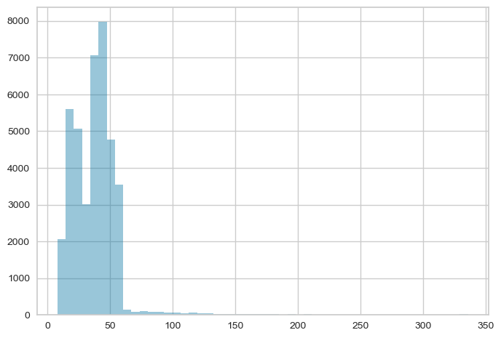
EXPLORATORY DATA ANALYSIS – Aggregate Amount of Time Spent by Patient in Hospital
Patients with Sepsis Onset
Patients with no Sepsis Onset
Number of patients
Number of patients
Hours in hospital
Hours in hospital

Slide 12
DATA PREPARATION – STEP BY STEP
Imputation of missing values
Impute missing data with nearest front/ back record for same patient
Defining onset (for septic patients) and pseudo-onset (for non-septic patients) and window
For each patient, take an aggregate of 3 hours before the real/pseudo sepsis onset
Exclude null values
Exclude variables with high correlation
Drop all rows with at least 1 Null value after imputation
Drop variables that are highly correlated with corr>0.6
Scale minority data class if imbalanced

Slide 13
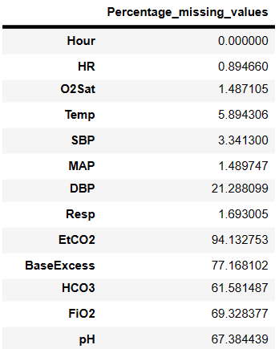
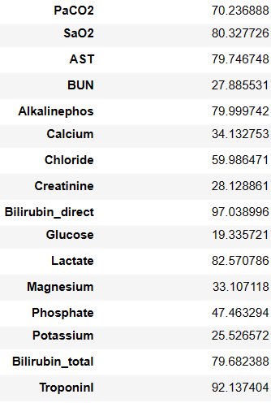
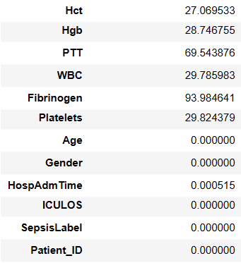
DATA PREPARATION – MISSING VALUES
Colour legend
Vital signs
Laboratory values
Demographics
Backfill and frontfill was applied to data, as it is not possible for readings to be taken every hour
Choose only columns with above 50% data for next step of data preparation
Notes:
Keep those columns with 50%

Slide 14
We need to define an observation window and prediction window.
Onset of
Sepsis
0 0 0 0 0 0 0 1 1 1 1 1
Hour 1
Hour 2
Hour 3
Hour 4
Hour 5
Hour 6
Hour 7
Hour 8
Hour 9
Hour 10
Hour 11
Hour 12
Hour 13

Slide 15
We need to define an observation window and prediction window.
Onset of
Sepsis
0 0 0 0 0 0 0 1 1 1 1 1
Hour 1
Hour 2
Hour 3
Hour 4
Hour 5
Hour 6
Hour 7
Hour 8
Hour 9
Hour 10
Hour 11
Hour 12
Hour 13
Observation Window: y hours
(3 hours in this case)
Prediction window: x hours
(1 hour in this case)

Slide 16
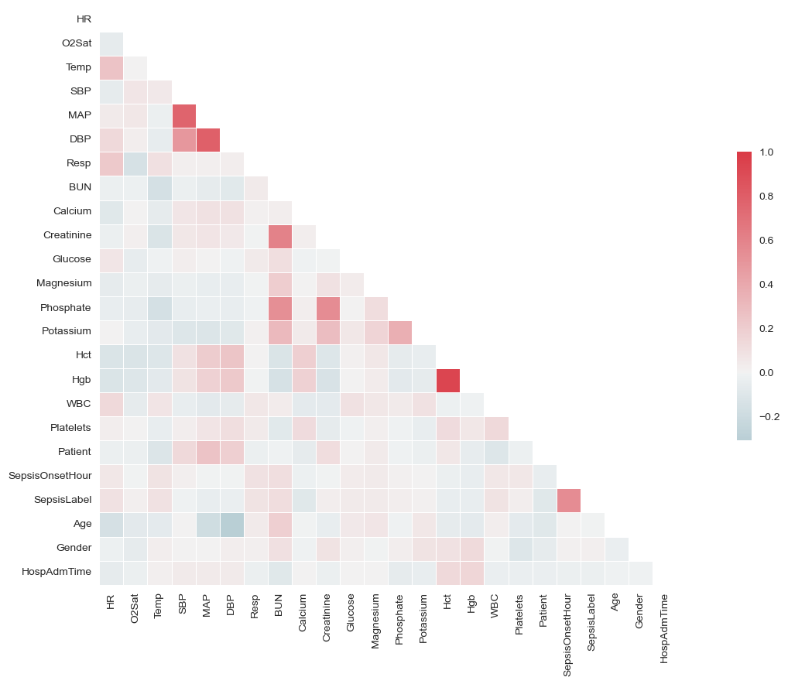
DATA PREPARATION – CORRELATED VALUES
Variables to omit from model
SepsisOnsetHour: Most values are 28h as the median time of onset was applied as pseudo-onset
Hgb and Hct highly correlated
MAP and DBP are highly correlated
Phosphate, Creatinine and BUN are all highly correlated

Slide 17
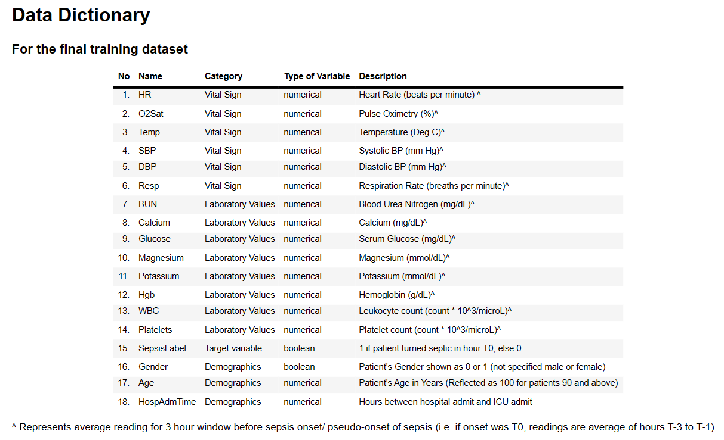
DATA PREPARATION – FINAL DATASET
Notes:
6 vital signs, 8 lab values and 3 demographics variables, 1 target variable

Slide 18
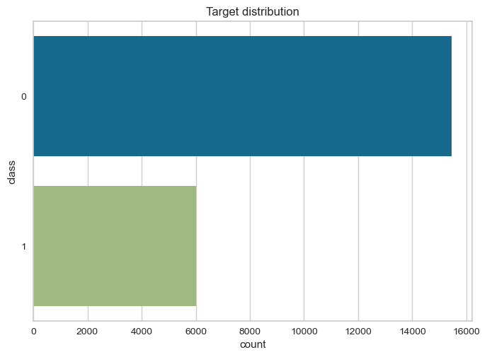
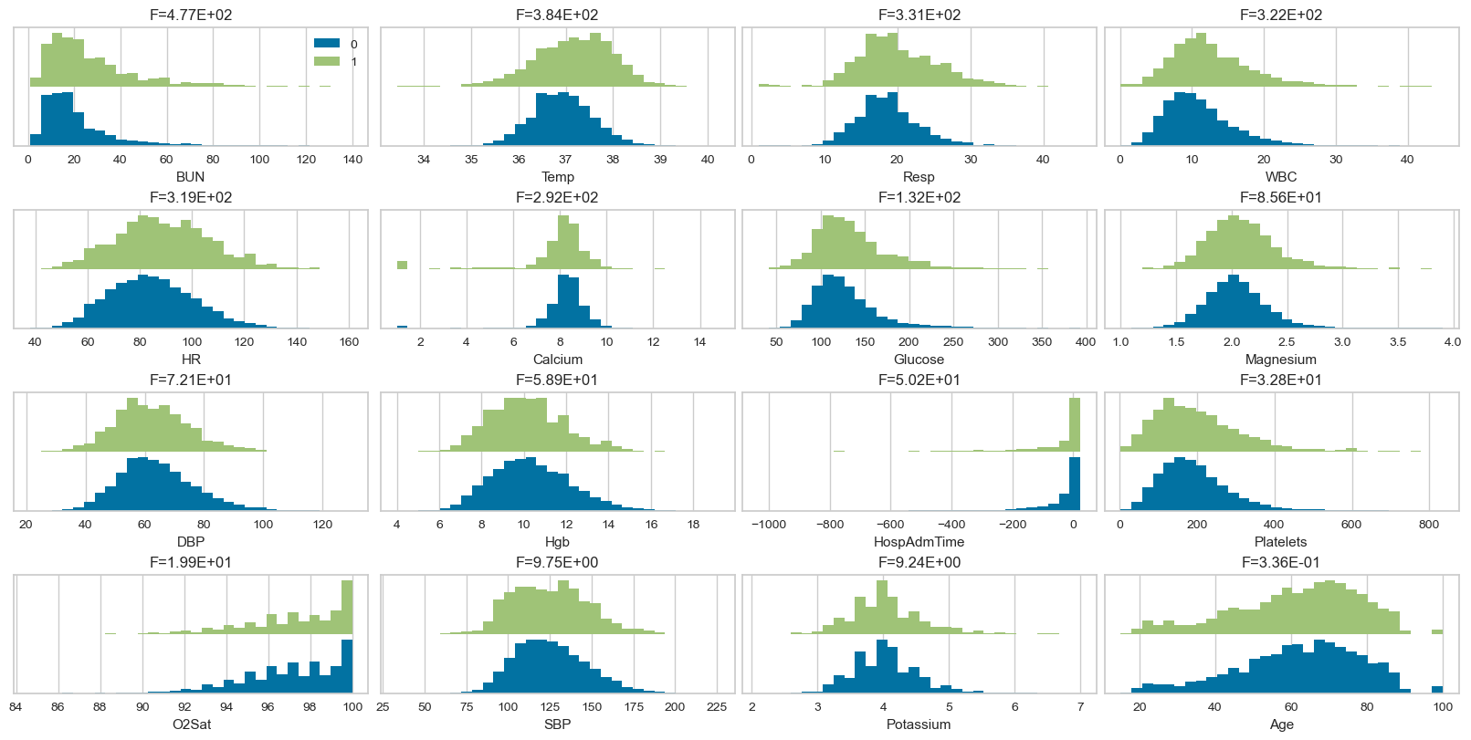
DATA PREPARATION – DISTRIBUTIONS OF FINAL MODELLING DATA

Slide 19
Metrics Comparison
Classifier Model | Train |  |  | Test
 | Accuracy | AUC | Recall | Accuracy | AUC | Recall
Random Forest | 0.9353 | 0.9754 | 0.9783 | 0.9086 | 0.9327 | 0.8317
Extra Trees | 0.9350 | 0.9717 | 0.9731 | 0.9109 | 0.9254 | 0.8099
KNN | 0.8403 | 0.9179 | 0.9381 | 0.7286 | 0.8054 | 0.7828
XGBoost | 0.9251 | 0.9733 | 0.9930 | 0.8547 | 0.9199 | 0.8864

Slide 20
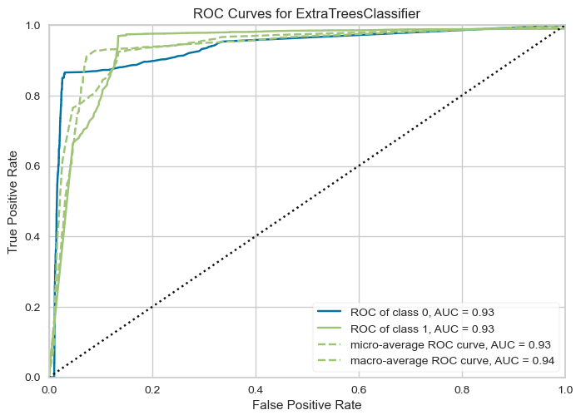
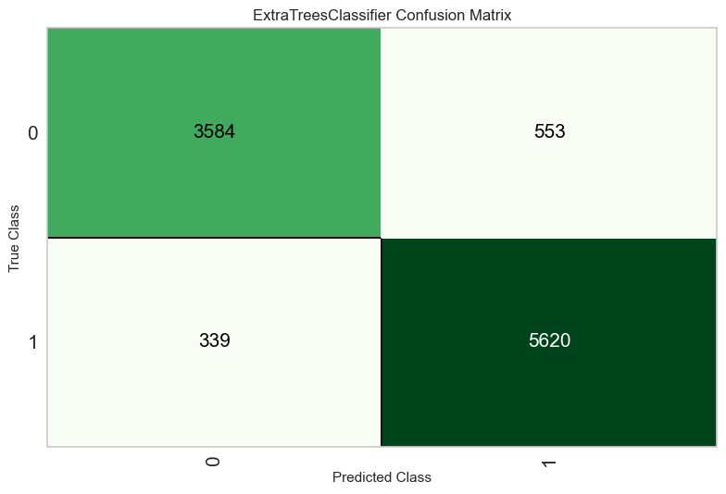
Best Model: Extra Trees Model
Area under ROC curve and Confusion Matrix
Notes:
RECALL provides an indicator of missed positive predictions

Slide 21
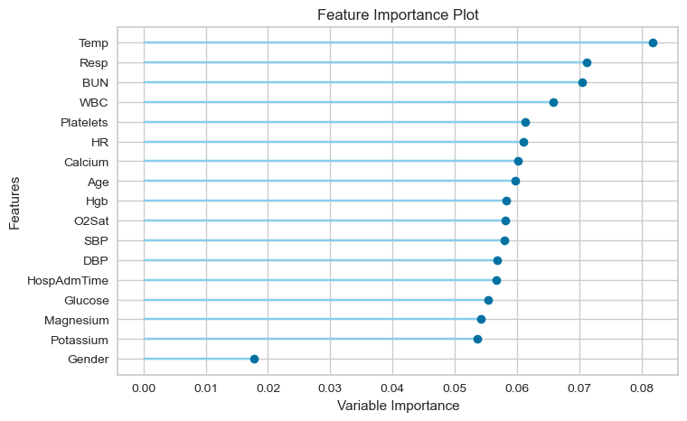
Extra Trees Model
Top Important Features
Colour legend
Vital signs
Laboratory values
Demographics

Slide 22
v
CONCLUSION
RECOMMENDATION
Best model (Extra Trees Classifier) has a high AUC score about 0.91 and Recall of 0.81.
Top 3 most important features for sepsis prediction (1h advance prediction window):
Temperature (deg Celsius)
Respiration rate (breaths per minute)
Blood Urea Nitrogen
*There is a good spread of Vital signs and Laboratory values among the best predictors, hence no conclusion on whether vital signs or laboratory readings are more important

Slide 23
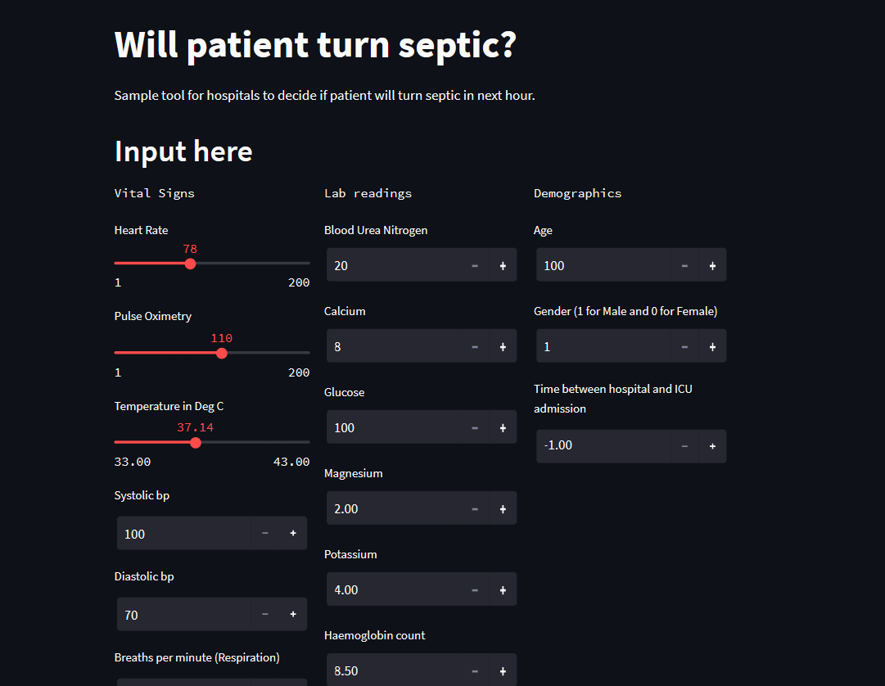
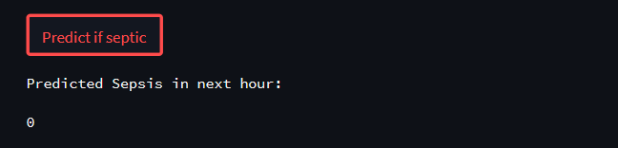
MODEL DEPLOYMENT
TOOL FOR MEDICAL PRACTITIONERS
Sample tool for medical practitioners to decide the urgency of prescribing patient with broad spectrum antibiotics and run blood tests to detect sepsis, given available resources.

Slide 24
BENEFIT OF THE TOOL
Prevention or early mitigation of sepsis could lead to fewer number of hours (Total hospital stay)
From graph below, 50% increase in mortality rate when antibiotics are administrated 1h late
If 90% of those who had administered antibiotics >1h in this study were given antibiotics at 0hours, assuming 25% mortality rate, we would have saved about 12 people in this study
In a pandemic setting where there are lack of attention from medical practitioners, this can serve as a support tool for non-practitioners to make decisions
Image adapted from (abstract P20).
Time from diagnosis of severe sepsis to antibiotics.... | Download Scientific Diagram (researchgate.net)

Slide 25
v
CONCLUSION
RECOMMENDATION
Recommendations
Adding the following features for better model performance:
Changes in vital signs over the past x hours (e.g. Difference in Heart Rates at hours T-1 and T-5)
Rate of change in vital signs over past x hours
Text analysis of doctor’s remarks
Whether doctor ordered a lab test could also be a good predictor of sepsis

Slide 26
Food for thought: Can whether doctor ordered a lab test can be a good predictor of sepsis onset?
Variable = EtCO2 | % septic | No. of cases
At least 1 measurement | 16.356% | 3,216
Not Measured | 6.468% | 37,120
Variable = HCO3 | % septic | No. of cases
At least 1 measurement | 8.607% | 20,217
Not Measured | 5.900% | 20,119
Variable = BaseExcess | % septic | No. of cases
At least 1 measurement | 13.097% | 7,040
Not Measured | 6.022% | 33,296
Variable = PACO2 | % septic | No. of cases
At least 1 measurement | 11.974% | 18,356
Not Measured | 3.317% | 21,980

Slide 27
PROJECT LIMITATIONS
Do not have external test datasets outside of this dataset
Only have data of sepsis onset; no data on septic shock or eventual death, hence cannot evaluate severity

Slide 28

THANK YOU

